Slide 1
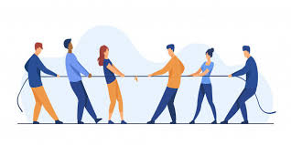
CONFLICT Management

Slide 2
GROUP MEMBERS
Muhammad Hasan
Shayan
Aaliyan Khan
Mohammad Ahmed

Slide 3
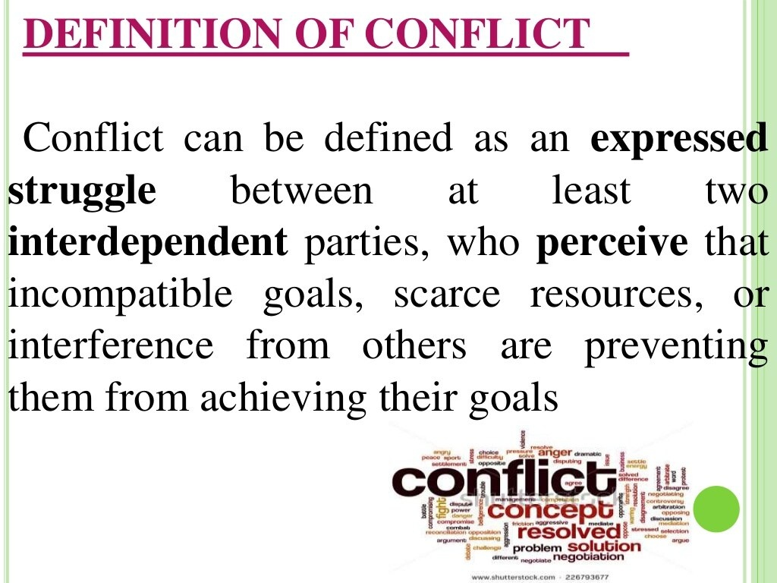
DEFINITION OF CONFLICT
Conflict can be defined as an expressed struggle between at least two interdependent parties, who perceive that incompatible goals, scarce resources, or interference from others are preventing them from achieving their goals

Slide 4
CAUSES OF CONFLICTS

Slide 5
GENERAL CAUSES OF CONFLICTS
Scarcity of resources (finance, equipment, facilities, etc)
Different attitudes, values or perceptions.
Disagreements about needs, goals, priorities and interests
Poor communication
Poor or inadequate organizational structure
Lack of teamwork
Lack of clarity in roles and responsibilities

Slide 6
TYPES OF CONFLICTS

Slide 7
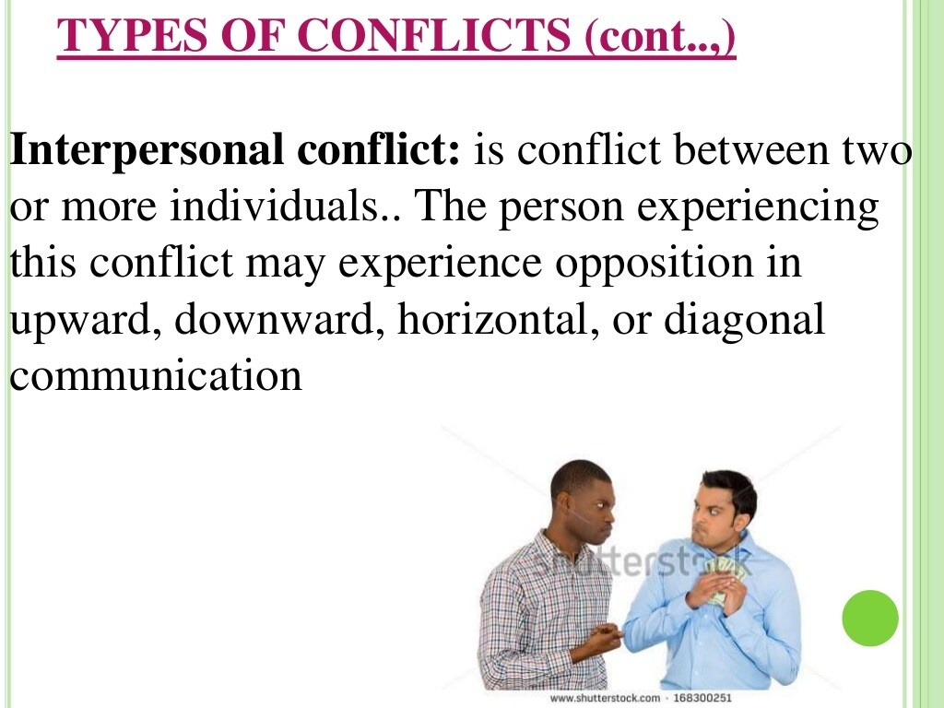
Intrapersonal conflict
An intrapersonal conflict occurs within an individual in situations in which he or she must choose between two alternatives
It is a conflict between two or more individuals.. The person experiencing this conflict may experience opposition in upward, downward, horizontal, or diagonal communication.

Slide 8
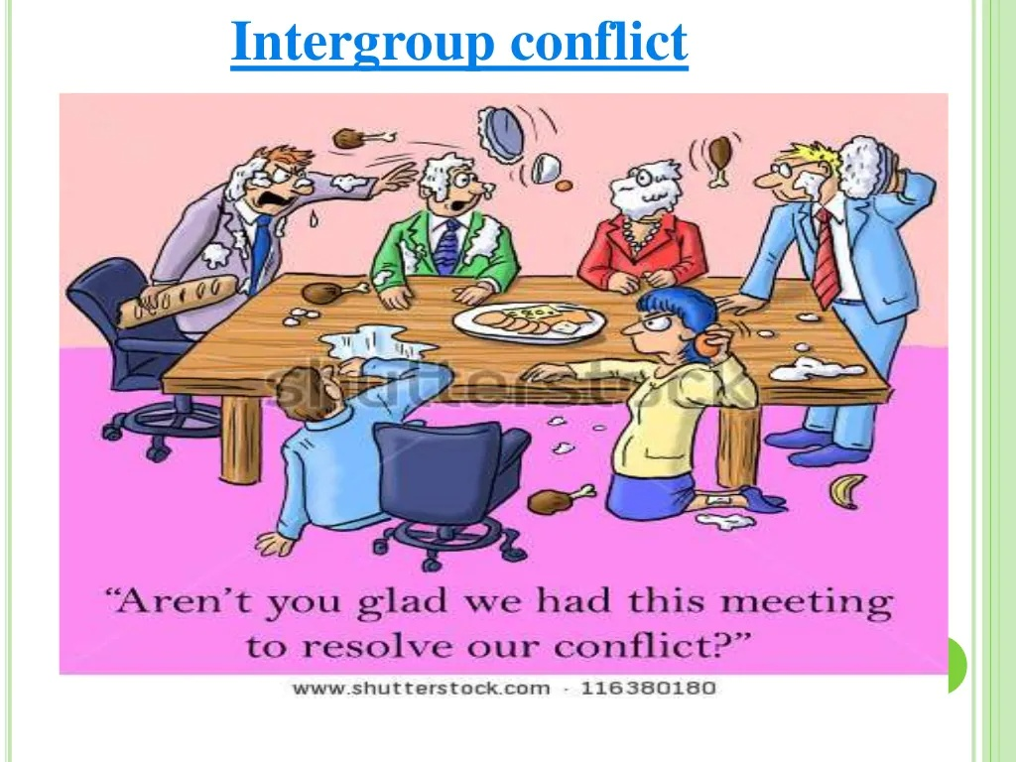

Slide 9
Intergroup conflict
It refers to disagreements or differences between the members of two or more groups or their representatives over authority, territory, and resources
Organizational conflicts: conflict also occurs in organization because of differing perceptions or goals..
Role ambiguity occurs when employees do not know what to do, how to do it, or what the outcomes must be
Role conflict occurs when two or more individuals in different positions within the organization believe that certain actions or responsibilities belong exclusively to them

Slide 10
EFFECTS OF CONFLICT IN ORGANIZATION
DESTRUCTIVE EFFECT | CONSTRUCTIVE EFFECT
STRESS | IMPROVE DECISION QUALITY
ABSENTEEISM | STIMULATES CREATIVITY
STAFF TURNOVER | ENCOURAGE INTREST
DE-MOTIVATION

Slide 11
SIGNS OF CONFLICT B/W INDIVIUALS:
Colleagues not speaking to each other or ignoring each other.
Deliberately undermining or not co-operating with each other, to the downfall of the team

Slide 12
OUTCOME OF CONFLICTS
Filley (1975) identified these 3 different position or outcomes of conflicts:
WIN-LOSE OUTCOME: occurs when one person obtains his or her desired results but the other fails.
LOSE-LOSE OUTCOME: There is no winner.
WIN-WIN OUTCOME: Mostly desirable outcome where both win.

Slide 13
CONFLICT MANAGEMENT
Identify the boundaries of the conflict ,the areas of agreement and disagreement, and the extent of each person’s aim.
Understand the factors that limit the possibility of managing the conflicts constructively.
Be aware of more the one issue is involved.
Be open to ideas ,feelings, and attitude expressed by people involved.
Be willing to accept outside help to mediate the conflict.

Slide 14
HANDLING CONFLICT SITUATION
Describe the person or group with whom the conflict is.
Analyze the cause of conflict.
Consider alternative strategies for conflict managment

Slide 15
HANDLING CONFLICT SITUATION
Choose strategies that will produce the best results.
Implement the decision
Evaluate the decision

Slide 16
CONFLICT MANAGEMENT STARTEGIES
It is important to take action as soon as a conflict surfaces so that bad feelings will no linger and grow. Three over all frameworks for the conflict management are
Defensive
Compromise
Creative problem-solving modes

Slide 17
DEFENSIVE MODE
The defensive mode produces feeling of winning in some and loss in others.
Separate the contending parties.
Suppress the conflicts.
Restrict or indicate the conflicts
Smooth it over or finance it through any organizational change.

Slide 18
COMPROMISE
With a compromise each party win something and loses something.
Use of a creative problem-solving mode produces feeling of gain and no feelings of loss for all conflicts participants.

Slide 19
CONFLICT-MANAGEMENT STRATEGIES (CONT…)
Creative problem-solving consists of these five steps:
Initiate discussion, timed sensitively and held in environment conductive to private discussion.
Respect individual differences.
Be emphatic with all involved parties.
Agree on solution that balance power and satisfy all the parties.

Slide 20
Conflict Handling
Blake and Moutons’ Model
Forcing
Withdrawing
Smoothing
Compromising
Problem Solving

Slide 21
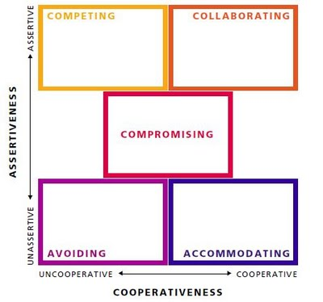
Thomas Kilmann’s Model:
Builds on Blake and moutons’ model
Has two dimensions: Assertiveness and Cooperativeness

Slide 22
Forcing:
Also known as competing.
Pursuing own concerns despite resistance from the other person
Examples:
When other, less forceful methods, don’t work
When you need to stand up for your own rights
When a quick resolution is required
As a last resort to resolve a long-standing conflict

Slide 23
Advantages:
May provide a quick resolution to a conflict
Increases self-esteem and draws respect in response to aggression or hostility
Disadvantages:
May negatively affect your relationship with the opponent
May cause the opponent to react similarly even if the opponent did not intend to be forceful originally
Taking this approach may require a lot of energy and be exhausting to some individuals

Slide 24
Collaborating:
Also known as problem-solving.
An attempt to work with the other person to find a win-win solution to the problem at hand
Examples:
When consensus and commitment of other parties is important
When addressing the interests of multiple stakeholders is required
When a long-term relationship is important
When you don't want to take full responsibility

Slide 25
Advantages:
Leads to a win-win outcome
Reinforces mutual trust and respect
Builds a foundation for effective collaboration in the future
You earn a reputation as a good negotiator
Disadvantages:
Requires a commitment from all parties
May require more effort and more time than some other methods
May not be practical when timing is crucial and a quick solution is required

Slide 26
Compromising:
Looks for an expedient and mutually acceptable solution which partially satisfies both parties.
Examples:
To reach temporary settlement on complex issues
When the goals are moderately important and not worth the use of more assertive approaches
When a long-term relationship is important
As a first step to develop trust between parties

Slide 27
Advantages:
Faster issue resolution
Can provide a temporary solution while still looking for a win-win solution
Lowers the levels of tension and stress resulting from the conflict
Disadvantages:
May result in a situation where both parties are not satisfied with the outcome
Doesn’t contribute to building trust in the long run
May require close monitoring and control to ensure the agreements are met

Slide 28
Avoiding:
Also known as withdrawing
when a person neither pursues their own concerns nor those of their opponent.
Examples:
When the issue is trivial and not worth the effort
When more important issues are pressing
When you see no chance of getting your concerns met
When you would have to deal with hostility
When you are unable to handle the conflict

Slide 29
Advantages:
Gives time to focus on more important issues
Gives you time to better prepare before acting
Withdrawing is a low stress approach when the conflict is short
Disadvantages:
May lead to weakening or losing your position
When multiple parties are involved, withdrawing may negatively affect your relationship with a party that expects your action

Slide 30
Accommodating:
Also known as smoothing
prioritizing concerns of other people first, rather than one’s own.
Examples:
When the issue is not as important to you as it is to the other person
When you accept that you are wrong
When you have no choice
When it is important to provide a temporary relief from conflict or buy time until you are in a better position to respond

Slide 31
Advantages:
Helps in protecting more important interests
Gives an opportunity to reassess the situation from a different angle
does not require much effort
Disadvantages:
The risk of being abused
May negatively affect your confidence
Makes it more difficult to transition to a win-win solution in the future
Some of your supporters may not like your response

Slide 32
NEGOTIATION
Negotiation in its most creative form is similar to collaboration and in its most poorly managed form may resemble a competing approach. Negotiation frequently resembles compromise when it is used as a conflict resolution strategy. During negotiation, each party gives up something, and the emphasis is on accommodating differences between the parties. Because we live in a world with others, we have conflicting needs, wants, and desires that must be constantly compromised.

Slide 33
PRE-PREPARATION FOR NEGOTIATION
Be adequately prepared.
Be able to use appropriate negotiation strategies.
Apply appropriate closure and follow-up

Slide 34
STEPS IN NEGOTIATION PROCESS
Before the Negotiation
For managers to be successful, they must systematically prepare for the negotiation. As the negotiator, the manager begins by gathering as much information as possible regarding the issue to be negotiated.
Adequate preparation
Tate (2005) suggests that managers should initially focus on seeking a bigger pie instead of dividing the pie up.

Slide 35
During the Negotiation
Negotiation is psychological and verbal. The effective negotiator always looks calm and self- assured.
There are many types of personalities, and it is necessary to negotiate with most of them. Preparation, however, is not enough. In the end, the negotiator must have clarity in his or her communication, assertiveness, good listening skills, the ability to regroup quickly, and flexibility.

Slide 36
Strategies commonly used by leaders during negotiation to increase their persuasiveness and foster open communication include the following:
Use only factual statements that have been gathered in research.
Listen carefully, and watching nonverbal communication.
Keep an open mind, It is important not to prejudge. Instead, a cooperative climate should be established.
Try to understand where the other party is coming from. It is probable that one person's perception is different from another's.

Slide 37
Always discuss the conflict. It is important to not personalize the conflict by discussing the parties involved in the negotiation.
Try not to be labour how the conflict occurred or to fix blame for the conflict. Instead, the focus must be on preventing its recurrence.
Be honest.
Never tell the other party what you are willing to negotiate totally. You may be giving up the ship too early

Slide 38
Tactics Not To Use During Negotiation
Ridicule or Belittling
The goal in using ridicule is to intimidate others involved in the negotiation. If you are negotiating with someone who uses ridicule, maintain a relaxed body posture, steady gaze, and patient smile. Body language must also remain relaxed and non-threatening
Inappropriate Questioning or ambiguous
Flattery
The person who has been flattered may be more reluctant to disagree with the other party in the negotiation, and thus his or her attention and focus are diverted.

Slide 39
Closure and Follow-Up to Negotiation
• State what has been agreed to
• Close on a friendly note
• Send a memo regarding what has been agreed to

Slide 40
CONSENSUS
Consensus is always an appropriate goal in resolving conflicts and in negotiation. Consensus means that negotiating parties are able to reach an agreement that all parties can support, even though it does not represent everyone's first priorities (Rowland & Rowland, 1997). Consensus decision making does not provide complete satisfaction for everyone involved in the negotiation, as an initially unanimous decision would, but it does indicate willingness by all parties to accept the agreed-upon conditions.

Slide 41
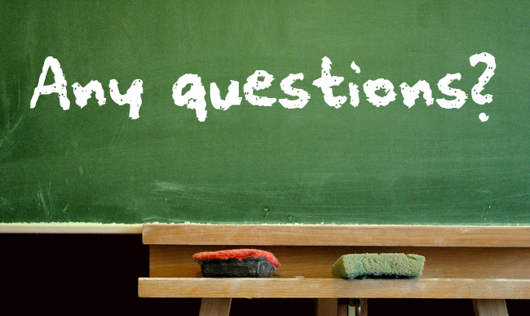

Slide 42
THANK YOU!

